Slide 1
CiteSeer Free Digital Library
Tutorial

Slide 2
About CiteSeer
Located at http://citeseerx.ist.psu.edu/
Development began in 1997 at NEC Research Institute and was taken over by Penn State in 2003
Digital library and search engine
Over 750,000 documents have been indexed
Specializes primarily in computer and information science literature
Maintained by The Pennsylvania State University College of Information Science and Technology
The following two slides show a list of features from CiteSeer and a screen capture of the CiteSeer home page……….

Slide 3
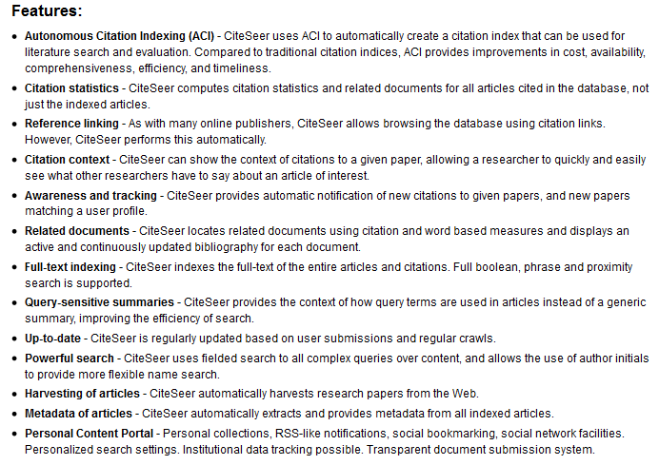
Features of CiteSeer Listed on Their About Us Page

Slide 4
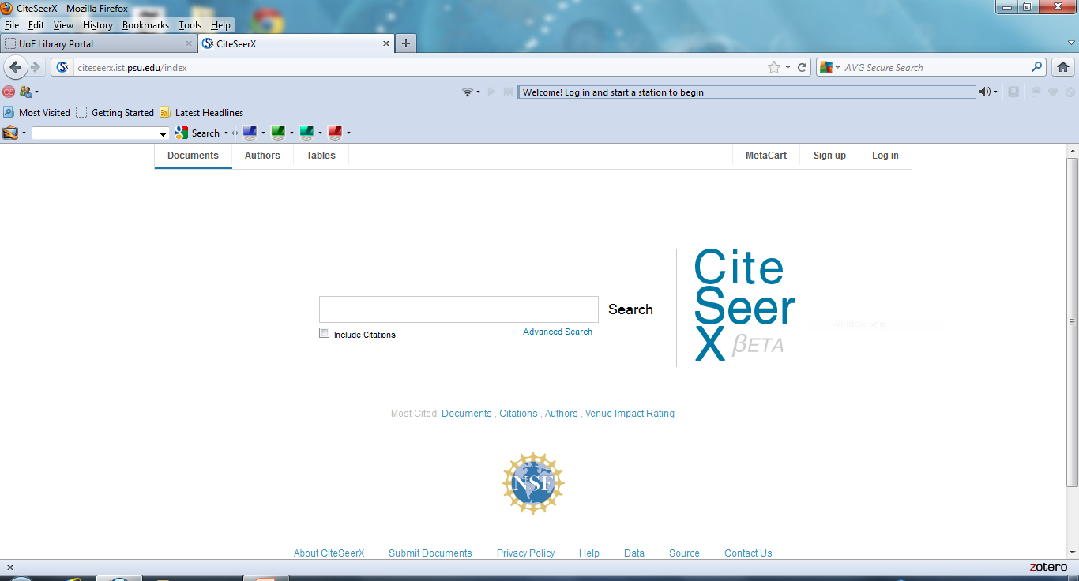
CiteSeer Home Page

Slide 5
Home Page
The home page provides direct access to the:
Most Cited Documents
Most Cited Citations
Most Cited Authors
The next three slides show a sample list of links from all three of the categories listed above. Each list of links is in descending order from most citations to least. These are articles, citations and authors works most cited by other authors

Slide 6
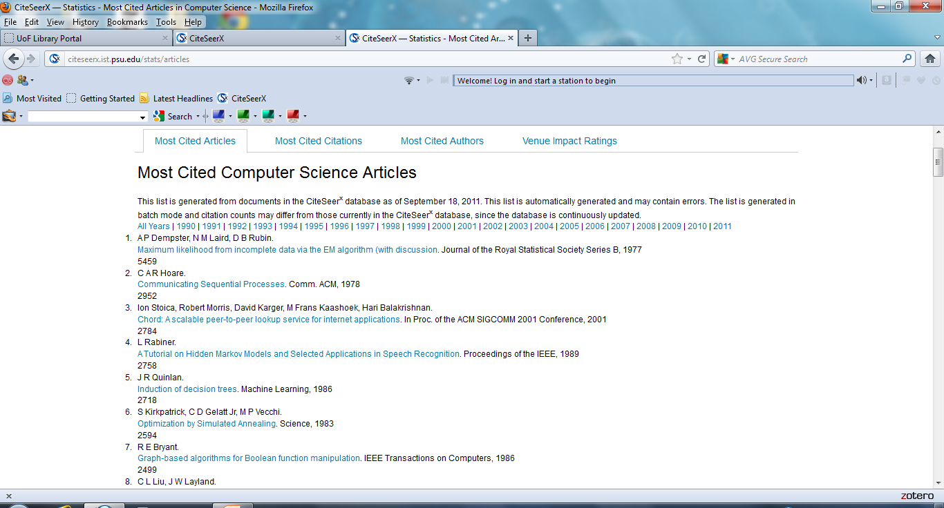
Most Cited Articles

Slide 7
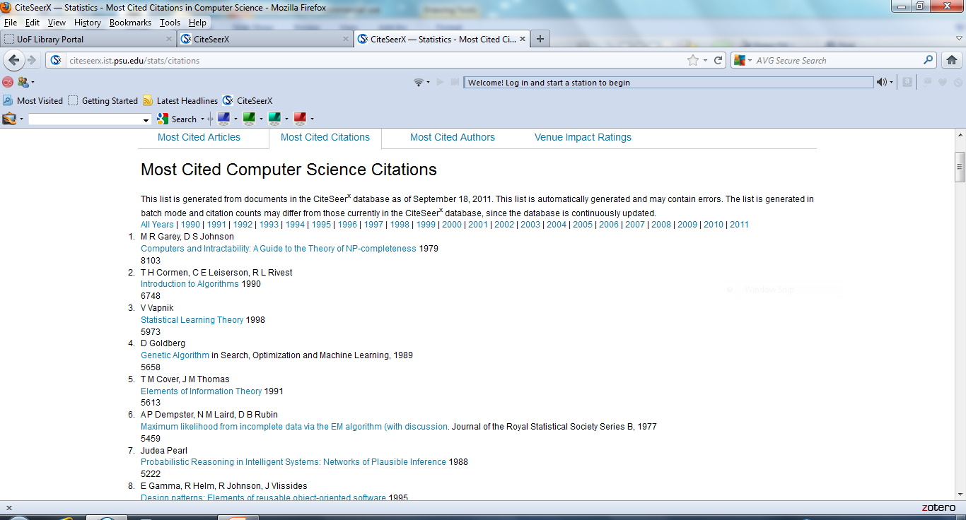
Most Cited Citations

Slide 8
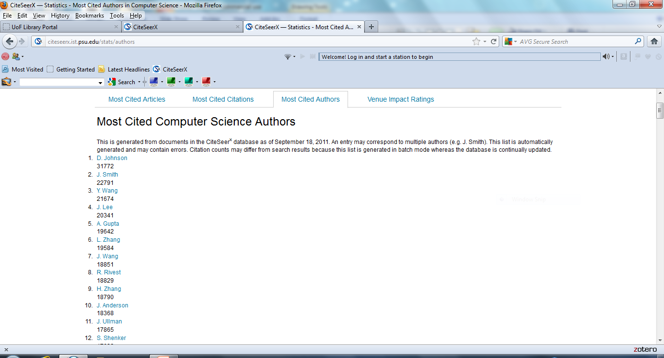
Most Cited Authors

Slide 9
Free CiteSeer Accounts
Users do not need an account to search and view articles
Obtaining a free account does allow the user to access several helpful tools such as saving and organizing articles into collections, monitoring changes in articles, saving article metadata and keeping up with database news
The next slide shows the CiteSeer homepage as seen by an account holder

Slide 10
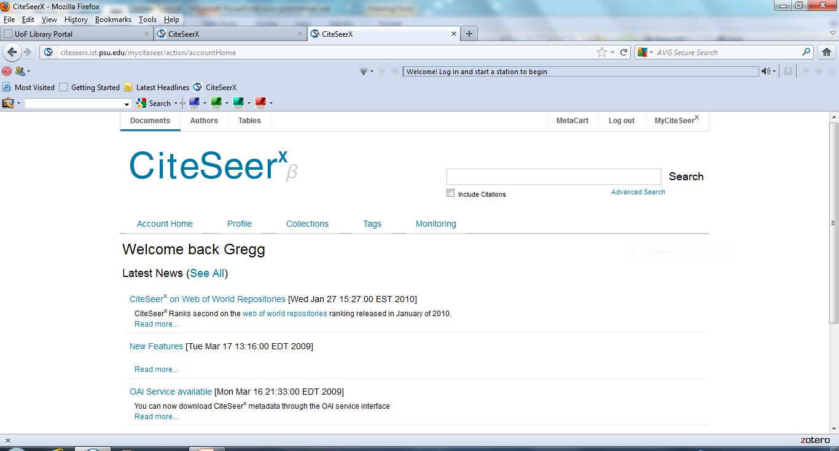
My CiteSeer Account Holder Page

Slide 11
CiteSeer Operation
Go to Advanced Search
Several Text search boxes. Recommend the use of key word
The search engine automatically defaults to the AND Boolean Operator between terms
The User can enter an article date range
Sort by Date (Descending) to see the most recent articles first

Slide 12
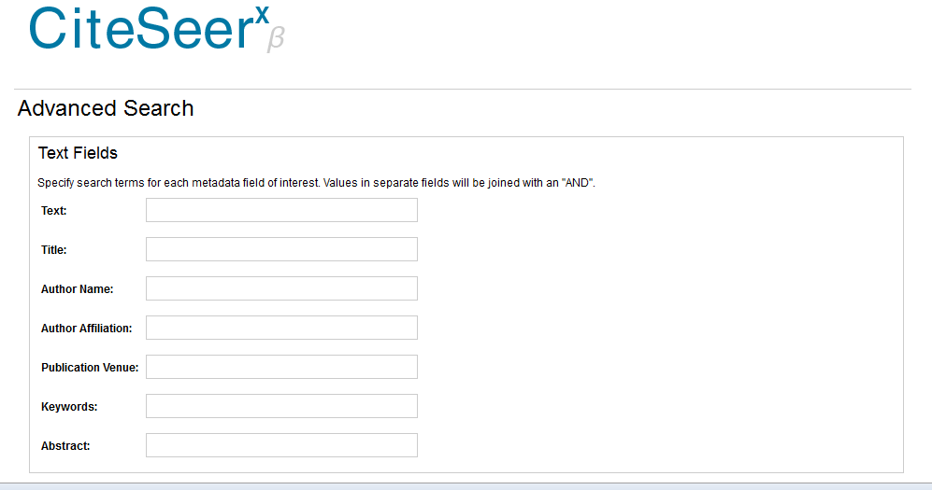
CiteSeer Advanced Search

Slide 13
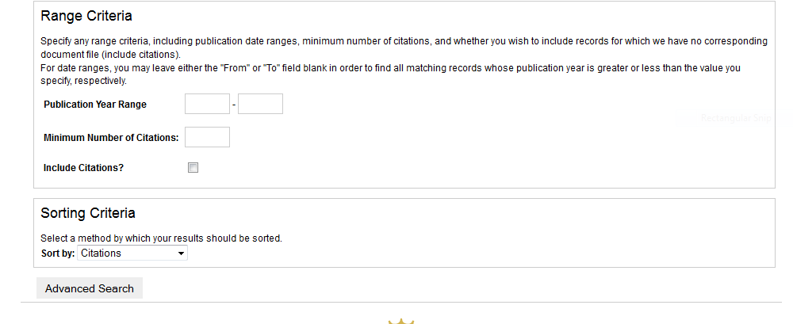
Lower Half of Advanced Search Page

Slide 14
Sample Search
Search query of “cloud computing” and security in the keyword search box
Date range controlled for articles between the years 2009 and 2011
Results are set to be viewed in descending order by date
The following slide is a screen capture of the search query followed by the search results

Slide 15
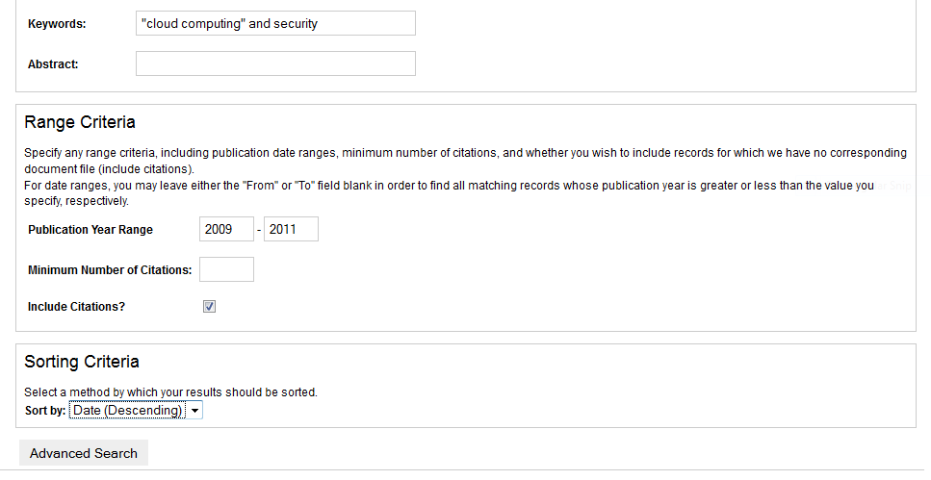
Sample Search

Slide 16
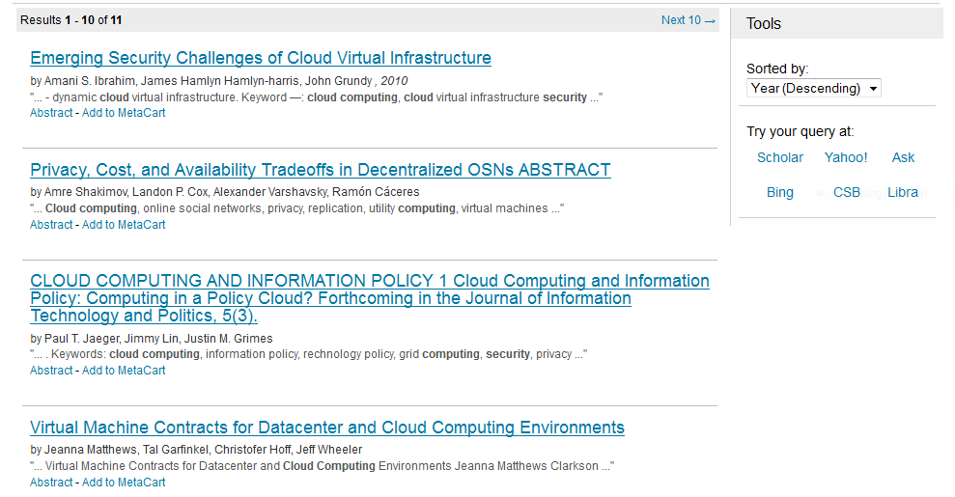
Search Results

Slide 17
Clicking into an Article
The following slide shows the entrance to an article after clicking on an article title from the results list
The next two slides after this illustrate the addition of the article to a saved collection

Slide 18
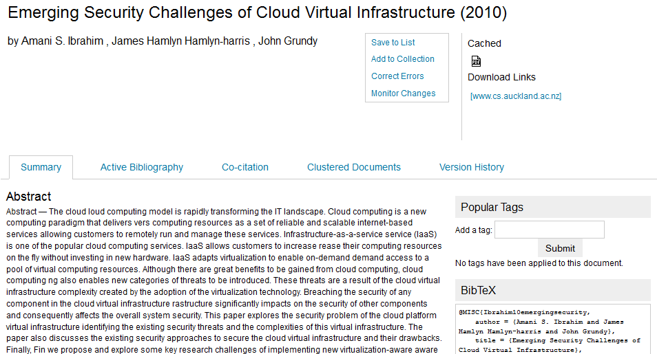
Article

Slide 19
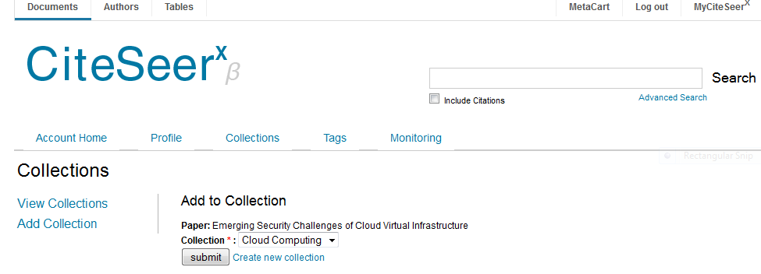
Add Article to Collection

Slide 20
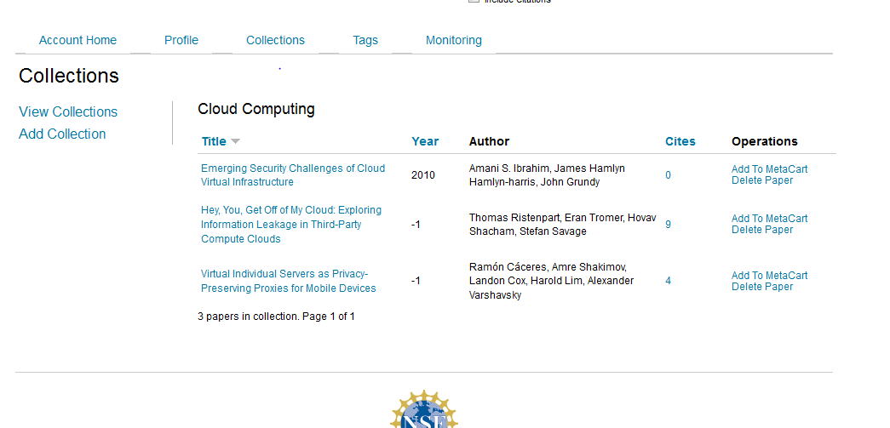
Collection

Slide 21
Monitoring Tool
The monitoring tool is accessible from the abstract page of each article
See the next slide…….

Slide 22
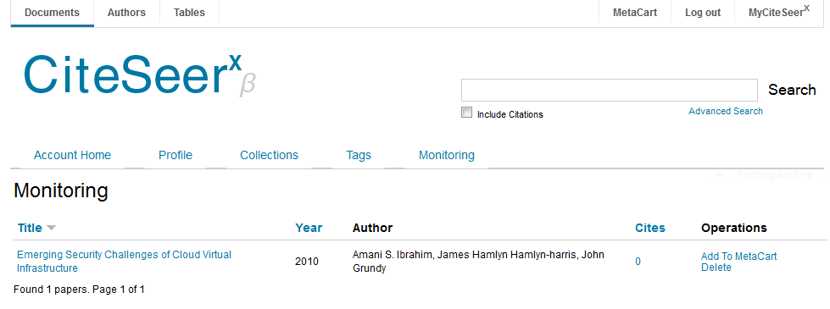
Monitoring Tool

Slide 23
MetaCart
From monitoring the user can choose to place the article into the MetaCart ……….

Slide 24
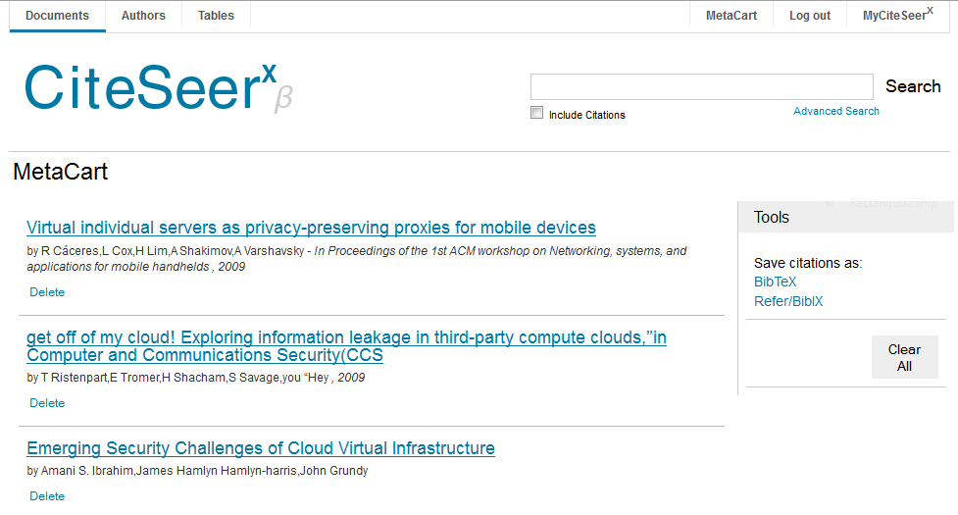
MetaCart Tool

Slide 25
Questions and Contact Information
If you have any questions please contact me.
Gregg Grunow
Online Librarian
ggrunow@ufairfax.edu
Or
librarian@ufairfax.edu

