Slide 1
Directory of Open Access Journals
(DOAJ)
A tutorial

Slide 2
Free Scholarly Journal Articles
DOAJ is a project providing searchable access to scholarly and scientific articles
All journals chosen by DOAJ must not received funding from either the journal’s readers or their institutions. In other words they must not be subscription supported
All participating journals must use some type of quality control system for their articles such as a peer review or similar or editorial review system

Slide 3
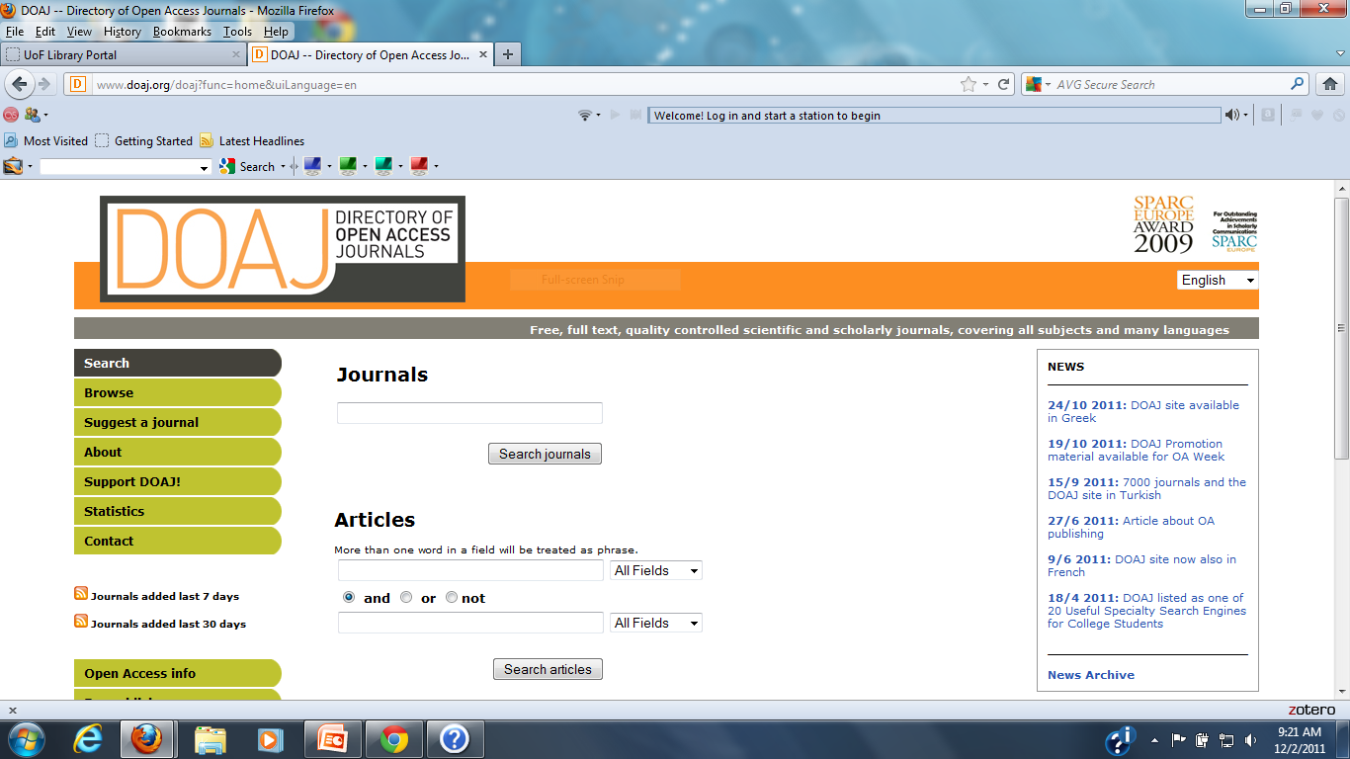
Directory of Open Access Journals Home Page

Slide 4
As of December 1, 2011
The Directory of Open Access Journals contains:
7306 journals
3439 article searchable journals
693435 articles
Within the above journals are:
310 Computer Science Journals
91 Technology Journals
127 Law Journals
227 Business Management Journals

Slide 5
Journal Browsing
DOAJ journals can be browsed by title alphabetically with an A B C D E……….tool bar
DOAJ journals can be browsed through a subject tree. There is a short list of major topic areas which with a mouse click can be expandable to a large list of topics and subtopics

Slide 6
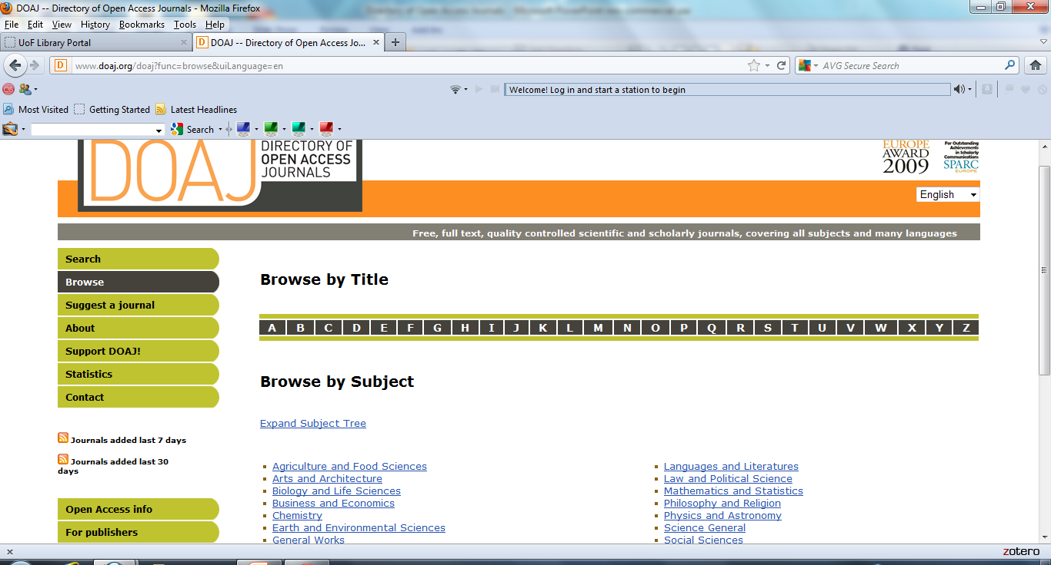
Journal Browse

Slide 7
Journal Searching
DOAJ journals can also be searched
There is a single journal search bar on the DOAJ home page for searching for journals as a whole. Not by individual articles
As an example, I did a journal search for the subject,
“Information Security” The results list of journal titles follow:

Slide 8
“Information Security” Journal Search Results
EURASIP Journal on Information Security
Information
Information Security: An International Journal
The International Arab Journal of Information Technology
International Journal of Communication of Networks and Information Security
International Journal of Computational Intelligence and Information Security
International Journal of Computer Network and Information Security
International Journal of Computer Science and Information Security
International Journal of Computer Science and Network Security
International Journal of Database Management Systems
International Journal of Doctoral Studies
International Journal of Network Security
International Journal of Security
Journal of Information Security
Journal of Security Engineering
Journal of Applied Computer Science and Mathematics

Slide 9
Article Search
The DOAJ home page contains a system for searching by article.
There are two search boxes connected with an ability to use the And, Or and Not Boolean search operators.
In addition each search bar has a drop down menu for adding further search options which include: Search By…All Fields, Title, Journal Title, ISSN, Author, Keywords and Abstract

Slide 10
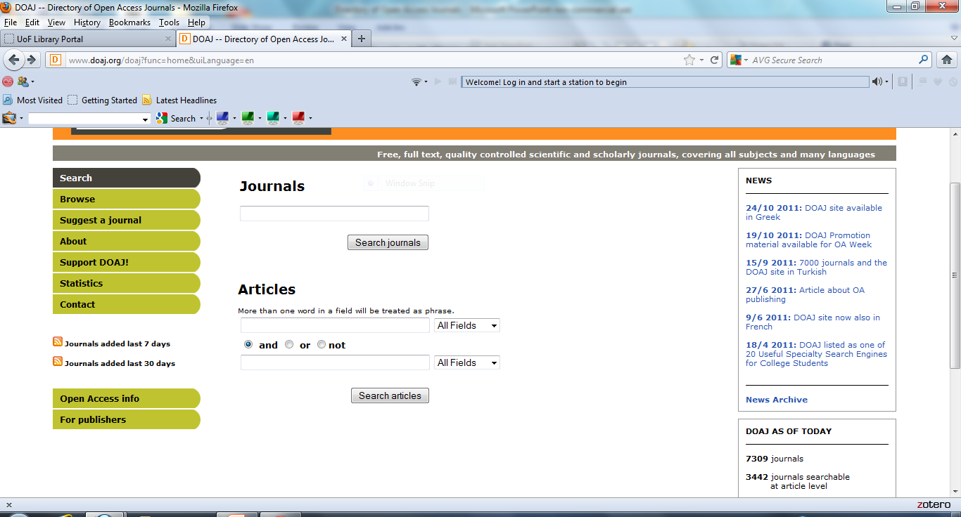
Journal and Article Searching

Slide 11
Questions?
If you have any questions please contact me
Gregg Grunow
Online Librarian
ggrunow@ufairfax.edu
Or
librarian@ufairfax.edu

