Slide 1
Education Resources Information Center (ERIC)
A Tutorial

Slide 2
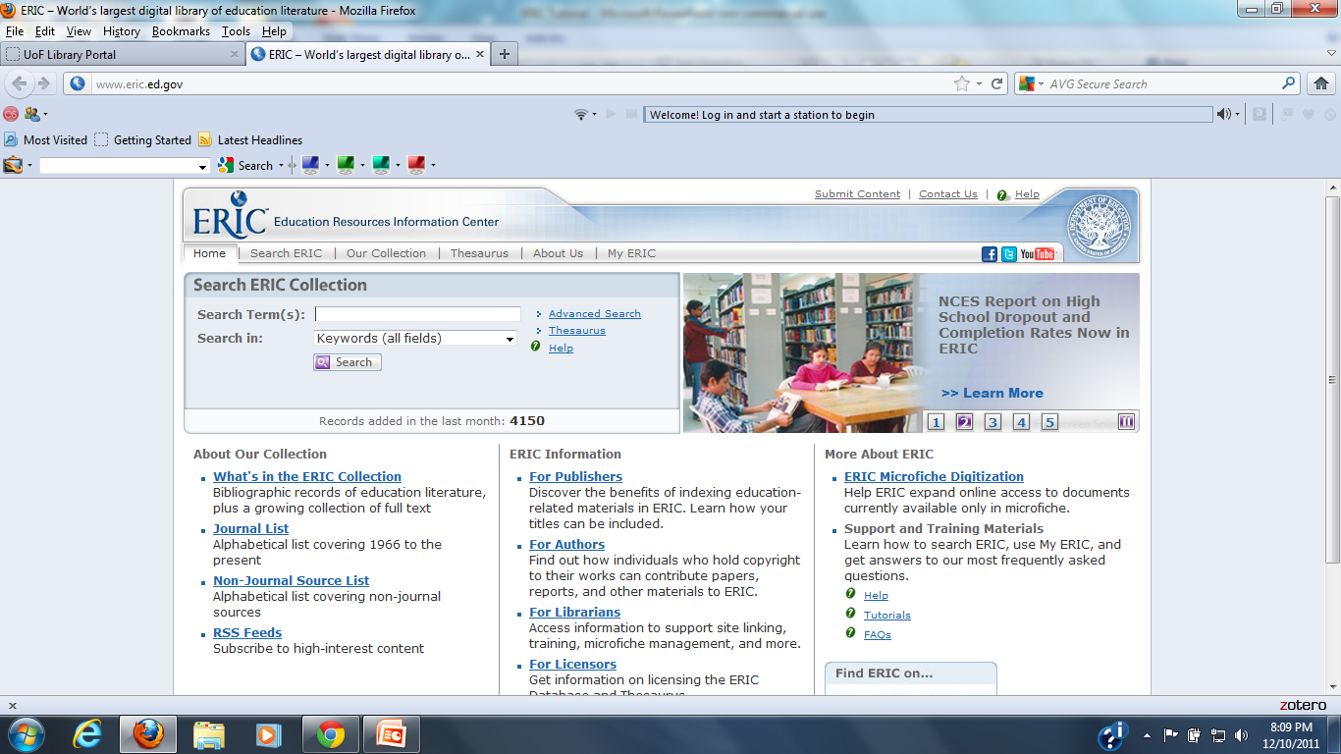
ERIC Home Page

Slide 3
ERIC Described
Free database dedicated education as it relates to each subject covered
The ERIC collection contains:
Journal Articles
Books
Research Synthesis
Conference Papers
Technical Reports
Policy Papers
Other Education Related Material
The next slide is a screen shot of database statistics to give a fuller picture of the database contents

Slide 4
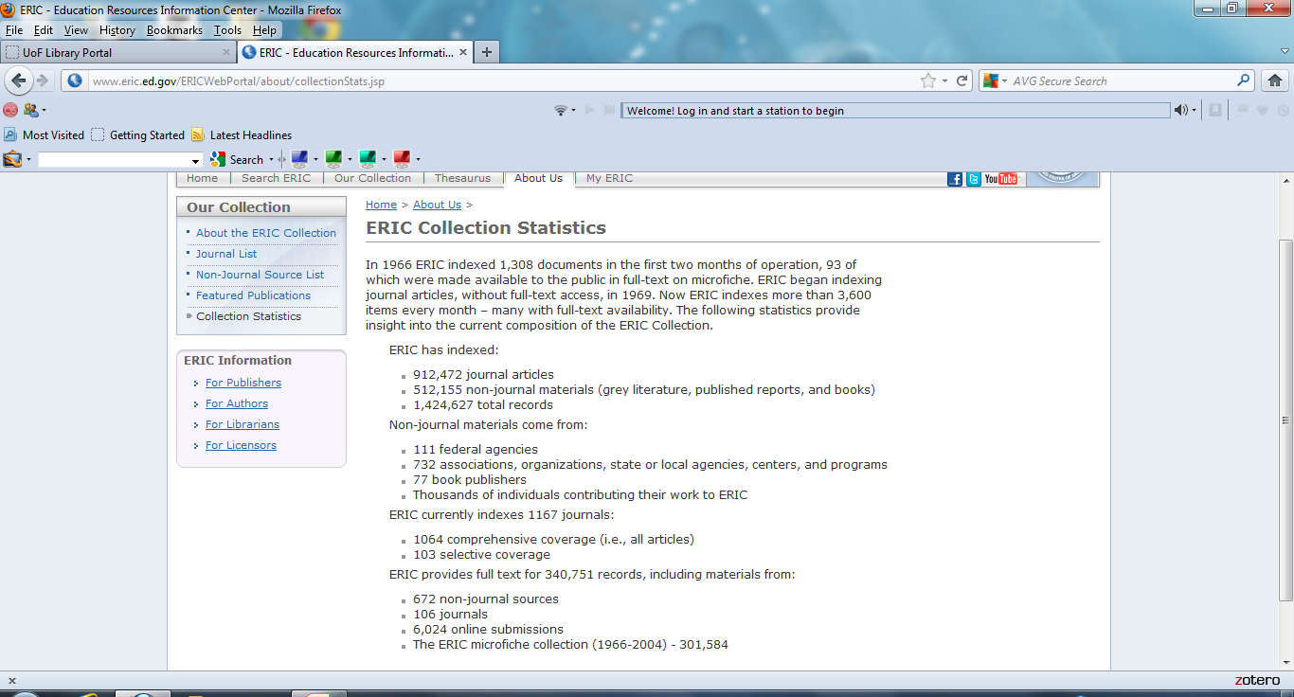
Collection Statistics

Slide 5
Journal List
As can be seen in the next two slides the journals within ERIC can be searched by title or browsed alphabetically by title
Entrance to this feature is obtained through the Our Collection tab on the tool bar across the top above the Search Eric Collection box

Slide 6
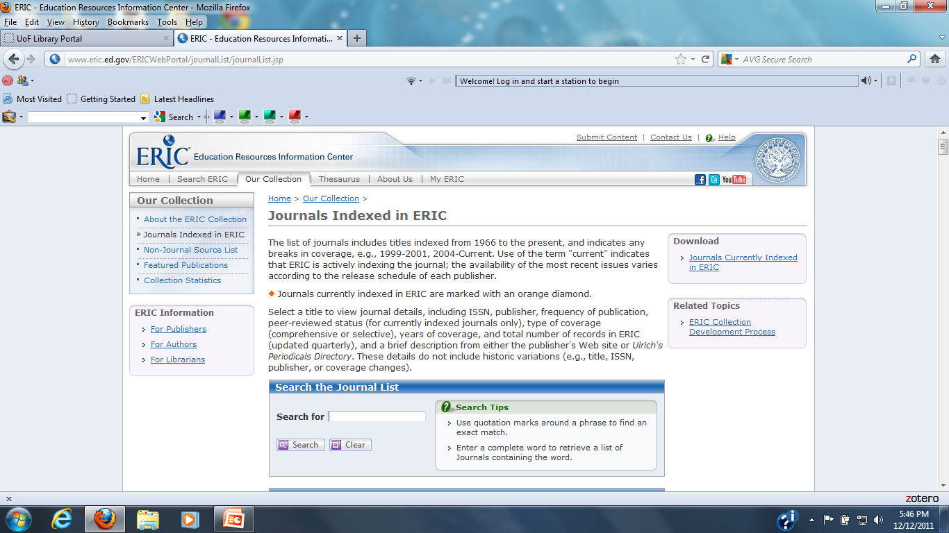
Journal List Search

Slide 7
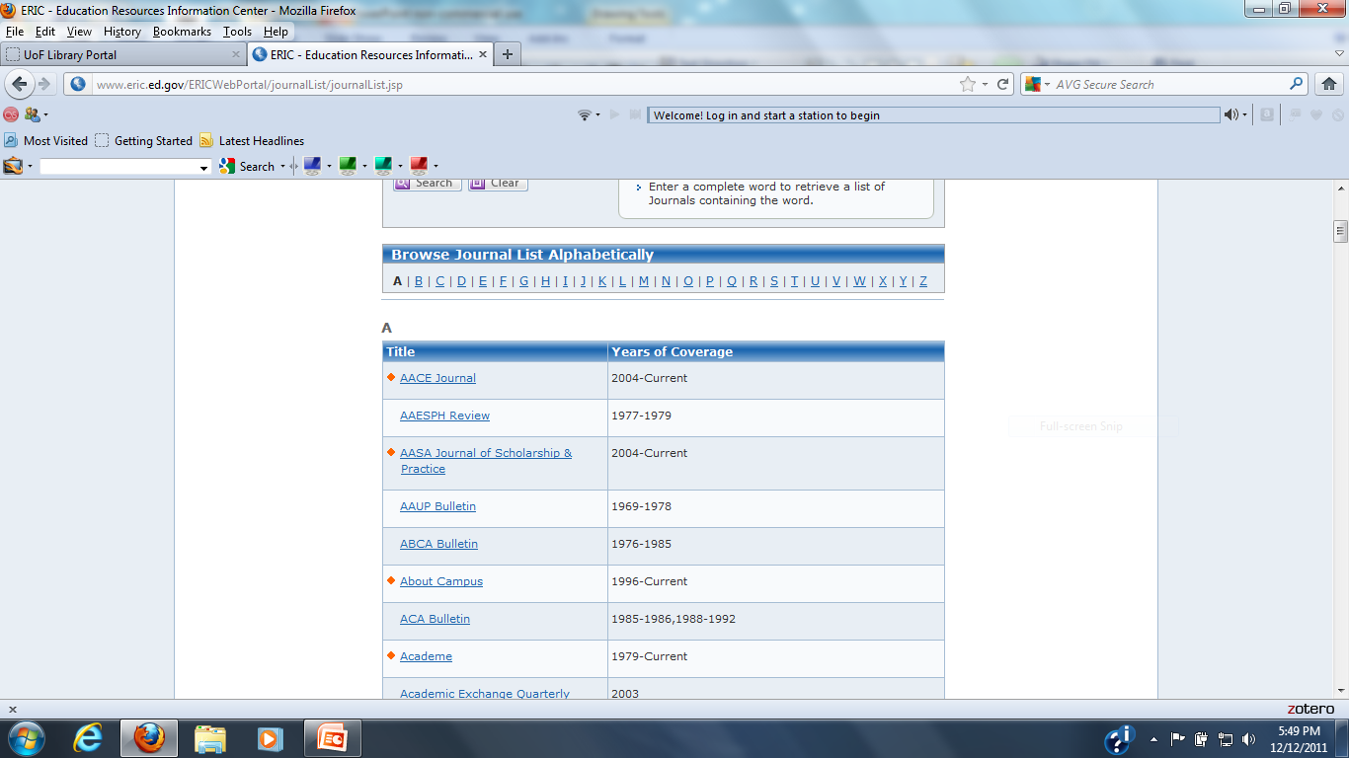
Journal List Browsing

Slide 8
Advanced Search
The link to the advanced search is located next to the search box on the ERIC home page
The advanced search contains three search boxes connected by a drop down menu of Boolean Search Operators. There is an option to add more search boxes
Advanced Search also includes the following options:
full text only, peer reviewed only, publication date range, publication type and educational level

Slide 9
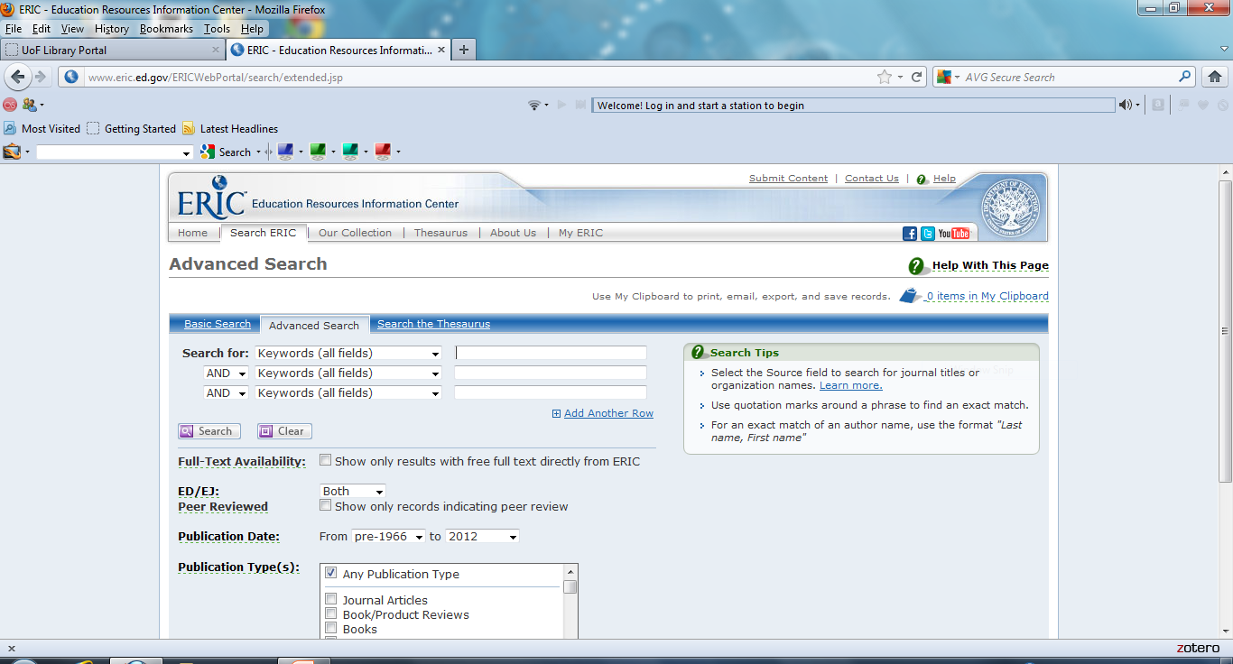
Advanced Search

Slide 10
Advanced Search Demonstration
The next two slides show a view of a search on information and security with the full text only option and peer reviewed only options chosen
On the result slide note the line that stated Peer Reviewed: Yes, the yellow highlighted search terms within the title and abstract and the link to the full text article in pdf. format

Slide 11
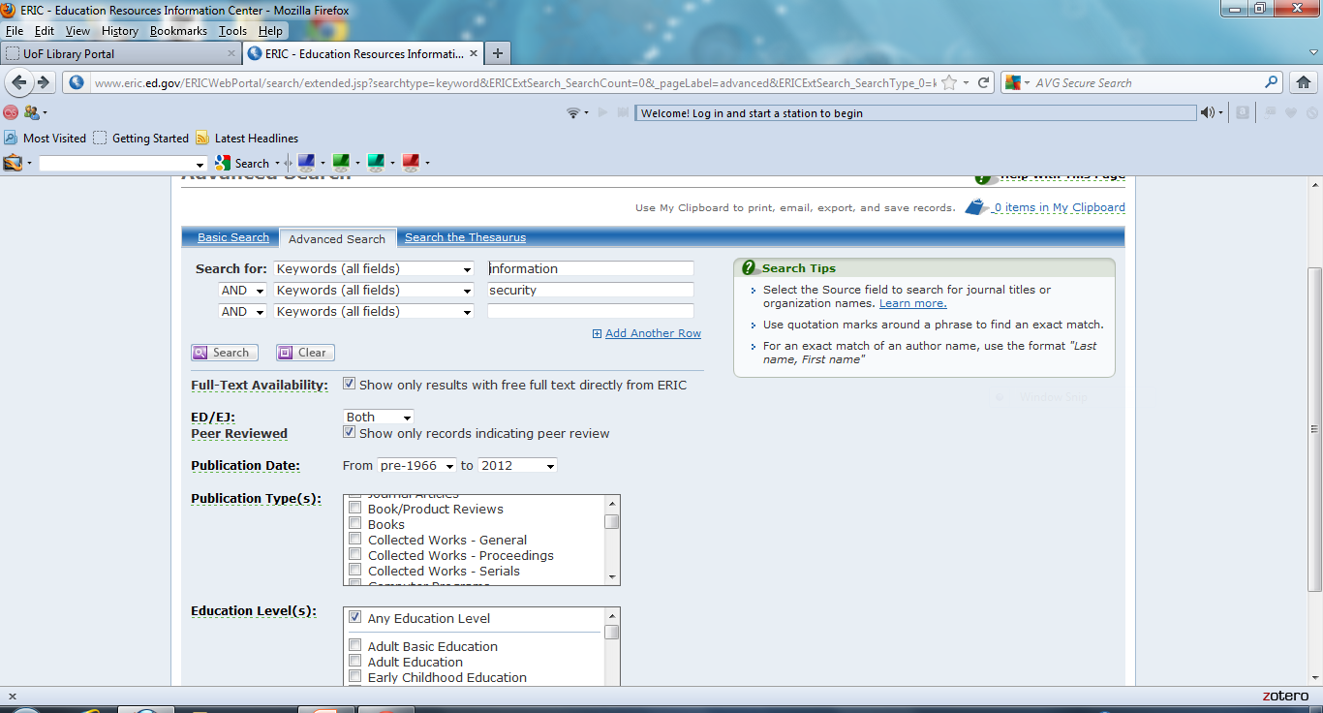
Advanced Search Demonstration

Slide 12
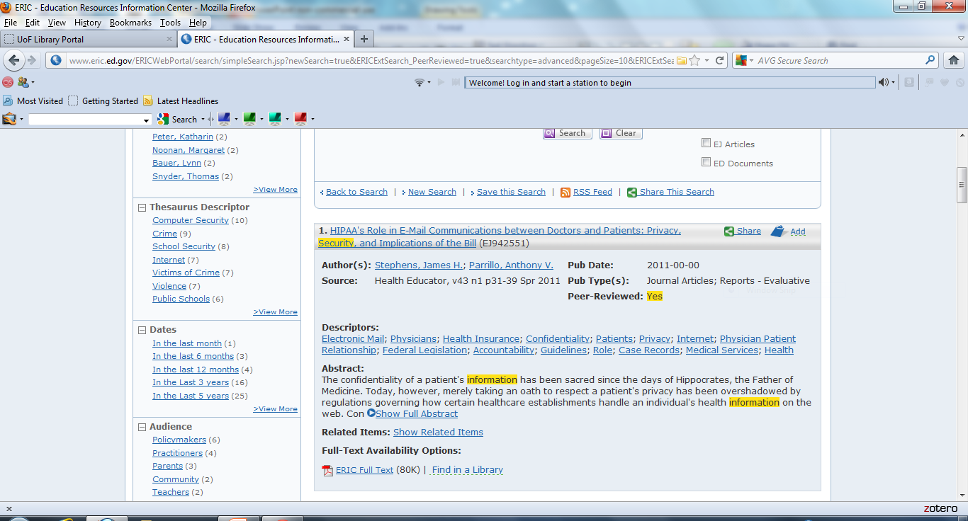
Search Result Example

Slide 13
Advanced Search Demonstration with a Twist
The next slide demonstrates the same search conducted again but without the full text only choice
Note in this example there will be many abstract only search results
Also note the feature allowing the user a way to find a full text version of the article

Slide 14
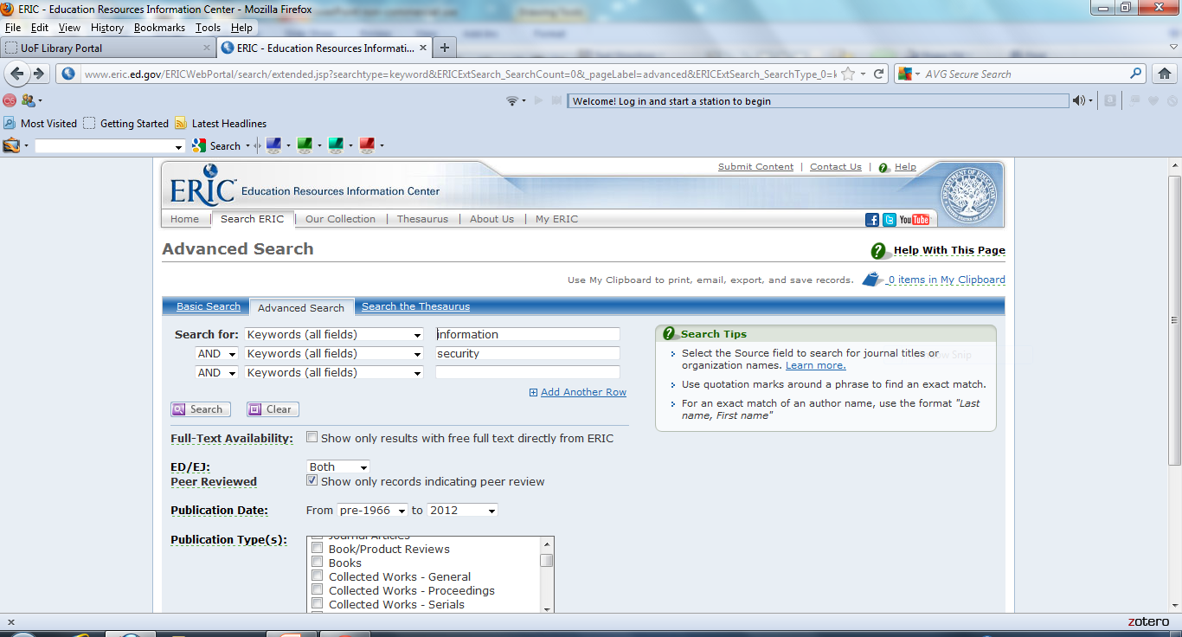
Non-Full-Text Search

Slide 15
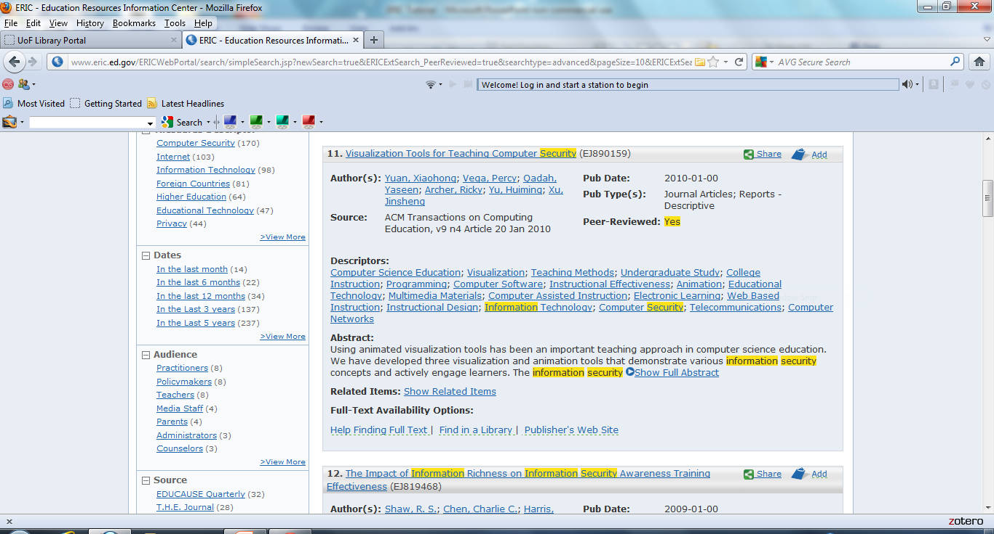
Abstract Only Result

Slide 16
WorldCat
WorldCat is basically a national library catalog which shows which member libraries across the country hold a particular title
In this example the article is in a journal published by ACM. Since the University of Fairfax has a subscription ACM’s digital library the full text article is accessible to students in the Library Portal
If this was not the case there will be more legwork involved

Slide 17
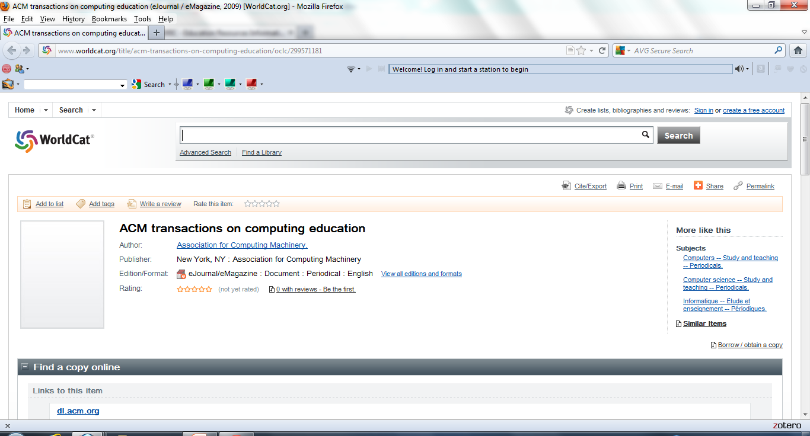
Enter WorldCat

Slide 18
WorldCat Locality Search
By entering your home city or zip code into WorldCat a list of the closest libraries holding the journal or book is created
In some cases a library close to where the student lives will have the journal and the student can go to that library to obtain an article
In other cases the closest library may be too far away to physically go to obtain the article. In this case an online librarian can be contacted at librarian@ufairfax.net to see if it can be obtained through interlibrary loan. ***Note**** this is not always possible

Slide 19
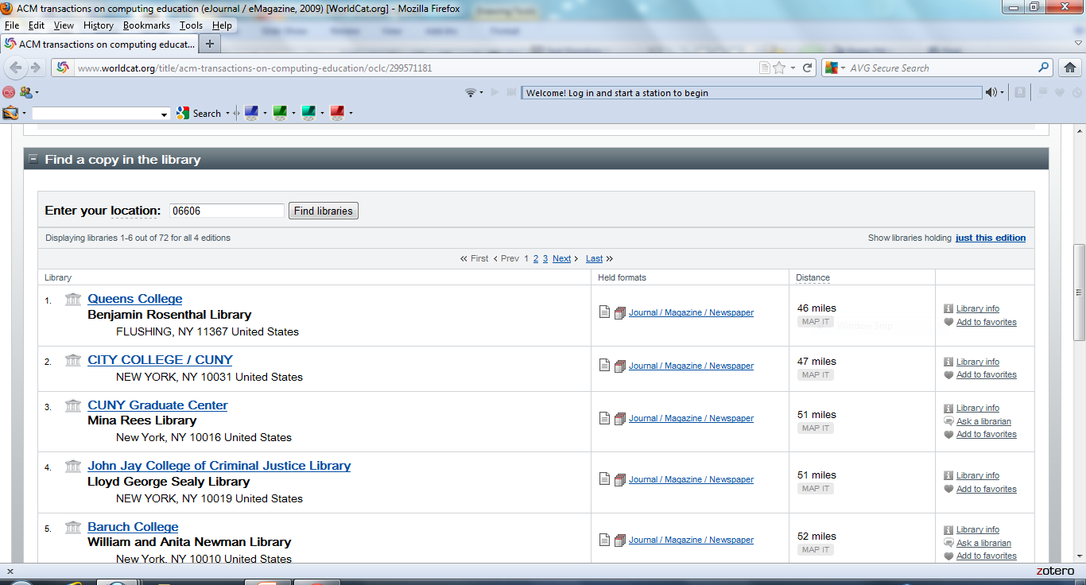
Libraries Closest to Zip code

Slide 20
Contact
If you have any questions please contact me:
Gregg Grunow
Online Librarian
At
ggrunow@ufairfax.edu
Or
librarian@ufairfax.edu

