Slide 1
National Institute of Standards and Technology (NIST) Virtual Library
A Tutorial

Slide 2
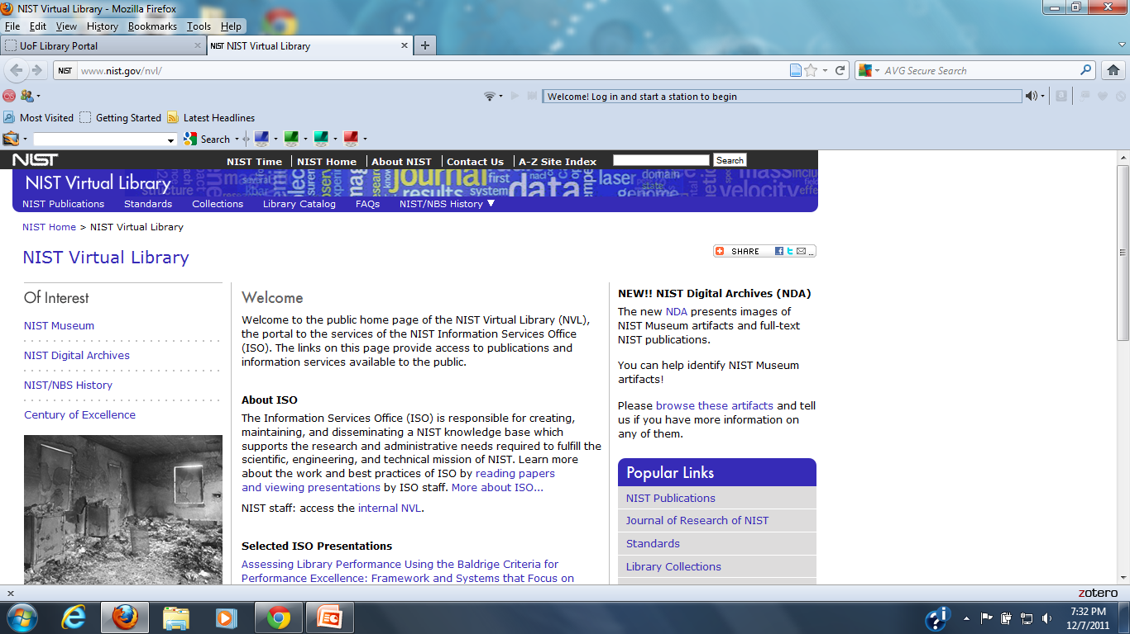
NIST Virtual Library Home Page http://www.nist.gov/nvl/

Slide 3
NIST Digital Archives
Access is from a link at the top right column of the home page
The articles and documents are from the following:
NIST Journal of Research
A Century of Excellence
NBS-NIST Histories
NBS-NIST Directors
NIST Museum Artifacts

Slide 4
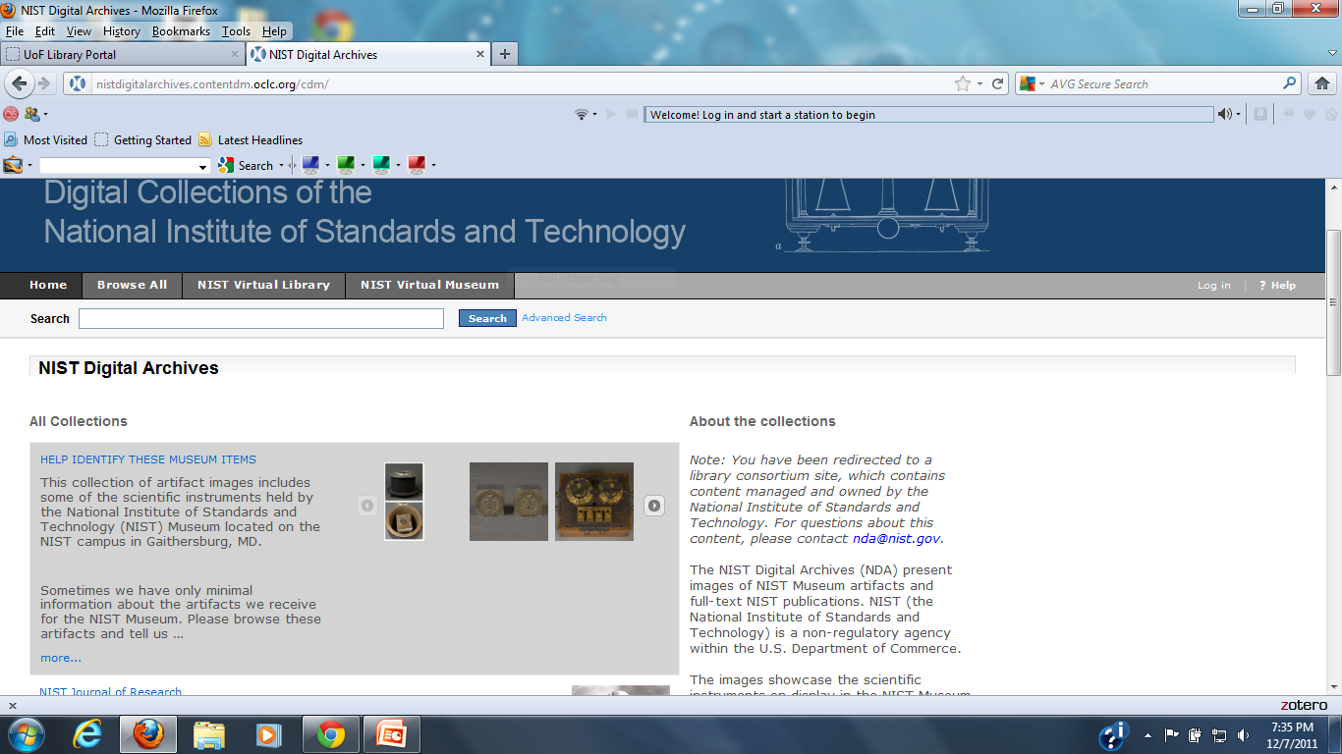
NIST Digital Archives Page

Slide 5
Digital Archive Advanced Search Choices
Click on advanced search
The user can add multiple search boxes with Boolean Operator connectors AND, OR, NOT
The user can choose to add a date range to the search

Slide 6
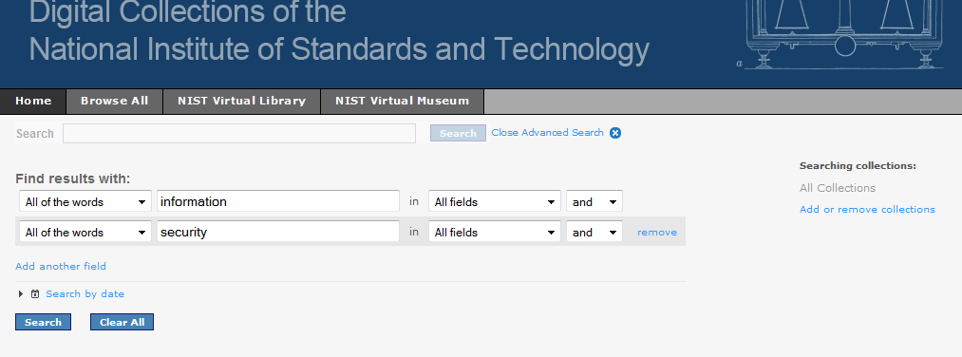
NIST Digital Archive Advanced Search

Slide 7
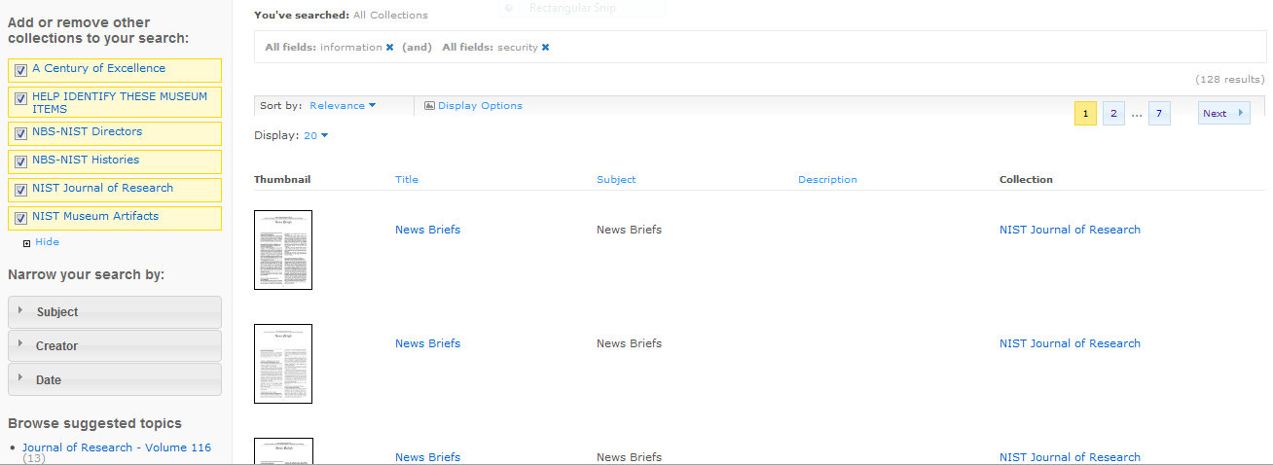
NIST Digital Archive Search Results

Slide 8
NIST Publications Search
Go to the NIST Virtual Library Home Page
In the right column is a box titled “Popular Links”
Click on NIST Publications
On the NIST Publications Page go down to the third paragraph and click on the NIST Publications Portal Link which will bring you to …………

Slide 9
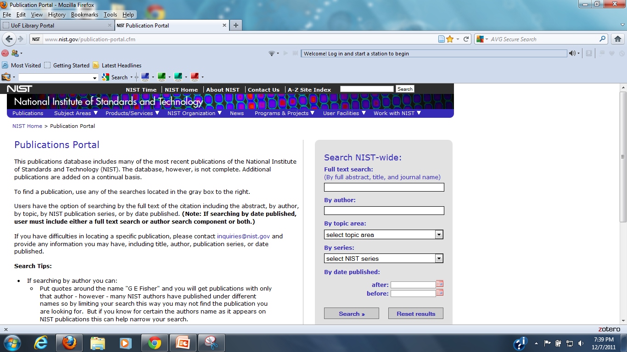
NIST Publications Portal

Slide 10
NIST Publications Portal Search
Use the search options on the right listed under Search NIST-Wide
The user can search by:
Full Text
Author
Topic
Series
The above search choices can be used in combination as well

Slide 11
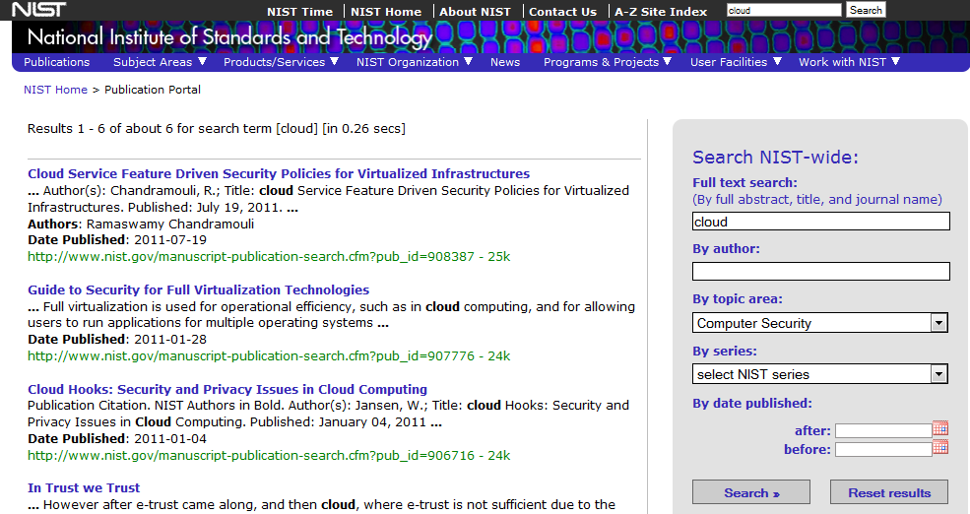
NIST Publication Portal Search Results

Slide 12
JOURNAL of Research of NIST Access
From the NIST Virtual Library Home Page go to the popular links box in the right column
Click on Journal of Research of NIST link
You are brought to a page that has links to the articles in the current journal edition
There is a link at the upper right to past issues which provides access to journals from 1948-2011
The articles are view able/brows able from this area. The Journal of Research can be searched from the Publication Portal and Archives

Slide 13
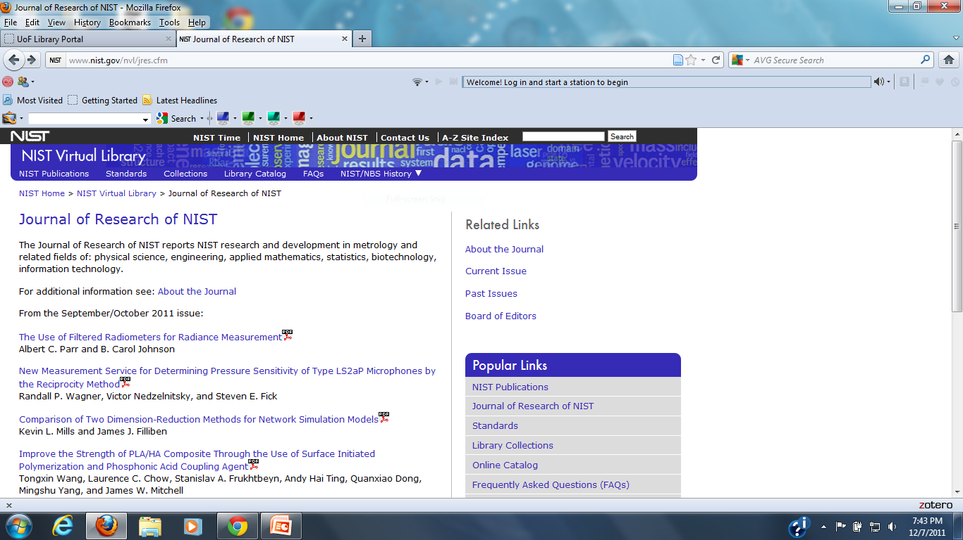
Journal of Research of NIST

Slide 14
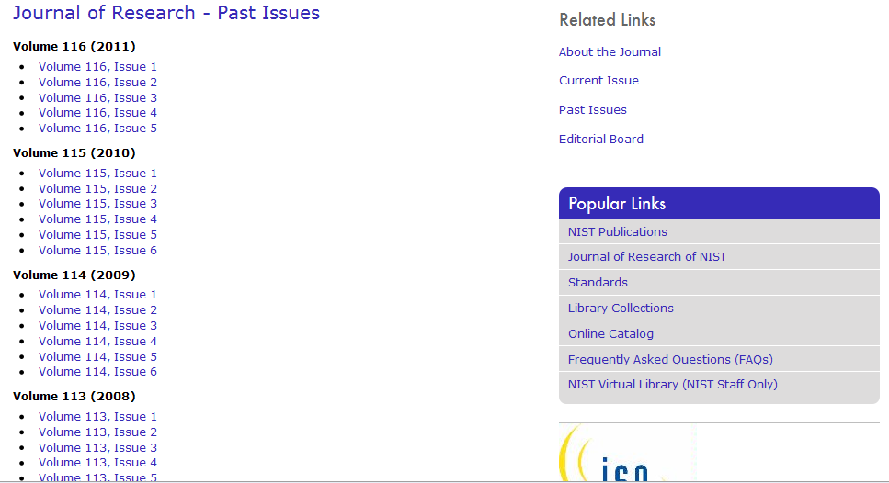
Journal Of Research of NIST Past Issues Page

Slide 15
Special Publication 800 Series (Computer Security)
Contains documents of interest to the computer security community
On the NIST Virtual Library home page click on the NIST Publications link under the Popular Link section in the lower right column of the page
At the bottom of the resulting page click on the Special Publication 800 Series link
Which leads you to the following page…….

Slide 16
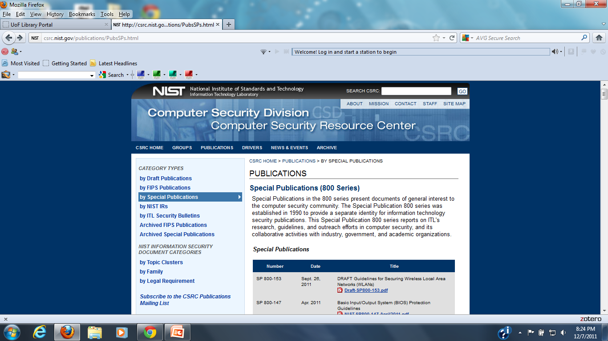
Information Security Related Publications

Slide 17
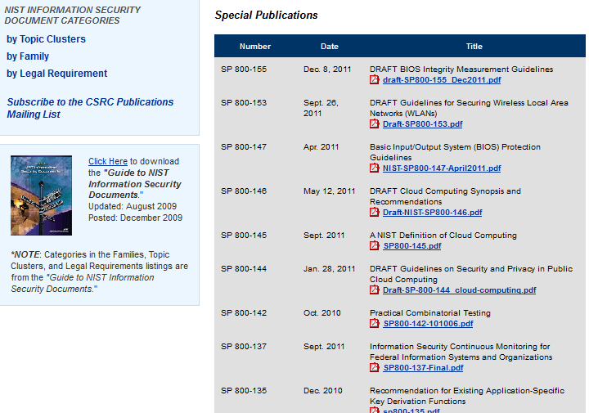
Partial Special Publications List

Slide 18
Questions/Contact Information
If you have any questions please contact
Gregg Grunow
Online Librarian
ggrunow@ufairfax.edu
Or
librarian@ufairfax.edu

