Slide 1
SpringerOpen
Tutorial
A Collection of Open Access Journals

Slide 2
SpringerOpen Overview
The URL is http://www.springeropen.com/
SpringerOpen provides a collection of open access journals in the areas of science, technology and medicine
All journal articles within the collection can be freely accessed, re-used and re-distributed as long as the original article is properly cited (See About SpringerOpen for additional details)
All of the articles within the SpringerOpen journal collection are peer-reviewed

Slide 3
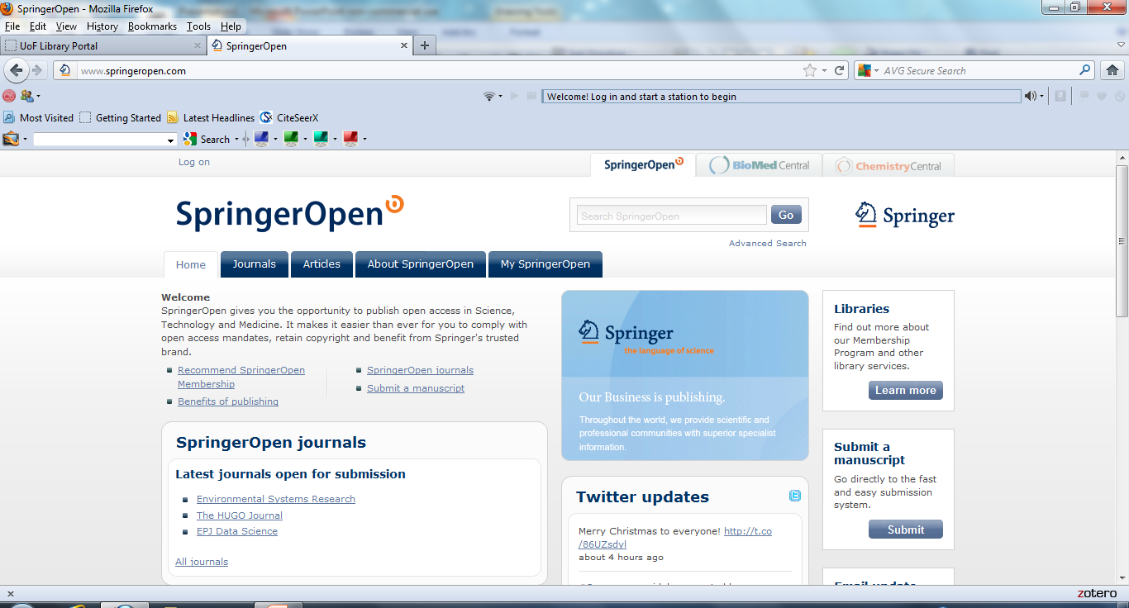
SpringerOpen Home Page

Slide 4
Journals Tab
From the Home Page there is a Journals button which leads to a browse able list of the journals included in the SpringerOpen collection
Titles are listed in alphabetical order

Slide 5
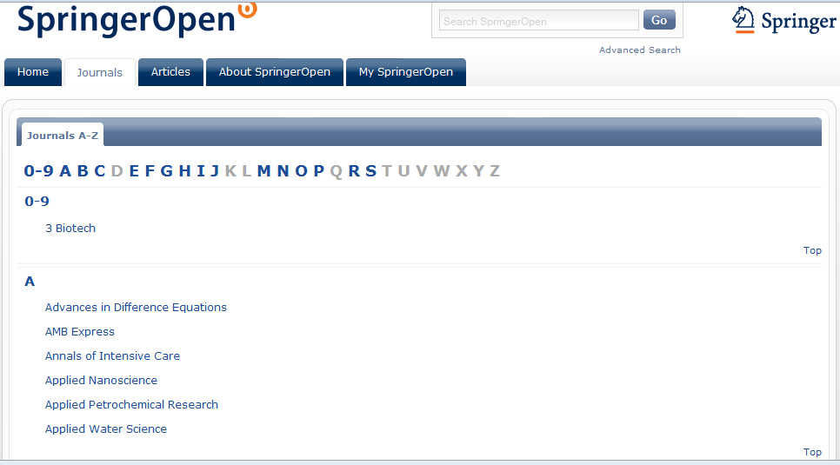
Journals

Slide 6
Clicking on a Journal
Clicking on one the journal titles brings the user to a page dedicated to the journal in question and provides information about that particular journal
Journal announcements are provided on this page
Access to latest articles and most popular journal articles is provided on this page
A screen capture for the “EURASIP Journal on Information Security” follows……………

Slide 7
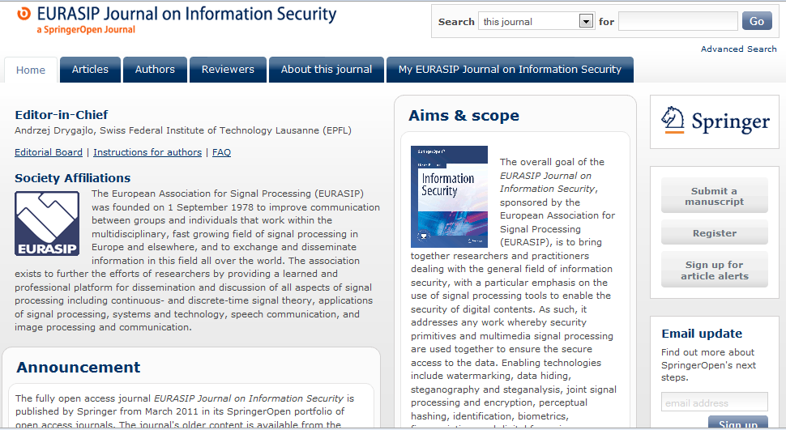
Journal Example

Slide 8
Articles Tab
The Articles tab on the SpringerOpen home page brings the user to a list of the most popular articles in the collection …………………

Slide 9
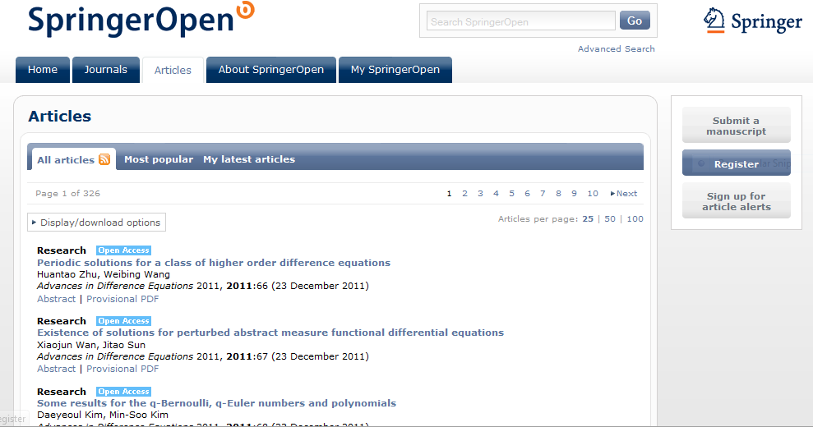
Most Popular Articles

Slide 10
Advanced Search Described
The advanced search feature has for search boxes allowing for many types of searches including All Fields, Title, Author and many more
Each box allows the search to be done for all words, any word or exact phrase.
The default between words or phrases in multiple search boxes is the Boolean Operator AND
If the user chooses the search for any word option, that will act as the Boolean Operator OR

Slide 11
Advanced Search Described, cont.
The fifth and final search box is preceded by the word Exclude. This box will act as the Boolean Operator, NOT
A date range can be added as well
The following three slides will demonstrate the use of Advanced Search with a query on “network security” and authentication. The date range is 2009-2011
Note that Advanced Search keeps a record of the users search history which can be referred back to

Slide 12
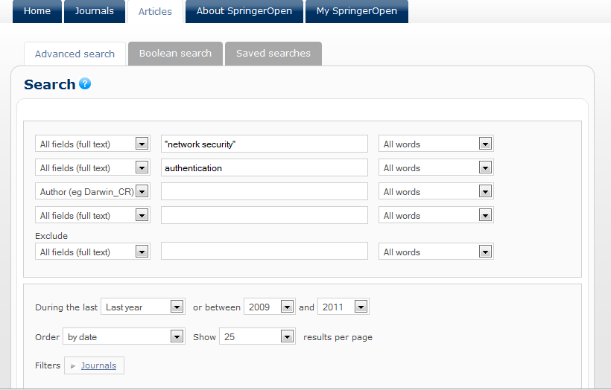
Advanced Search

Slide 13
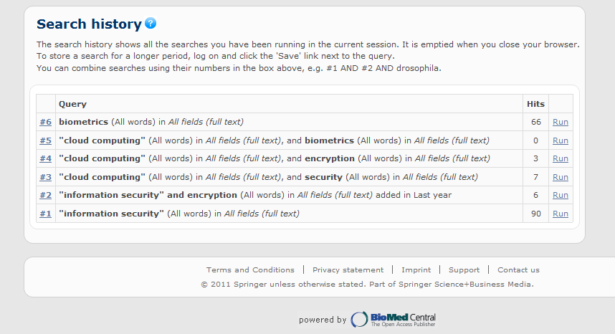
Advanced Search History

Slide 14
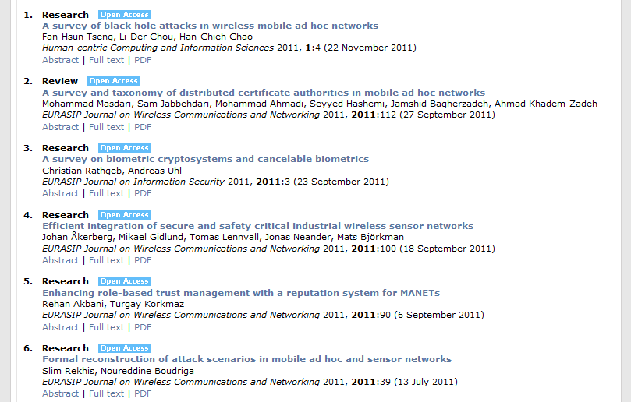
Advanced Search Results

Slide 15
Article Level
Once the user has chosen an article to read the article will be viewable automatically in html. There is an option to view the article in pdf. format
At the article level there are options to locate other articles by the same authors, related articles, and to download articles into citation management programs such as Zotero and Mendeley

Slide 16
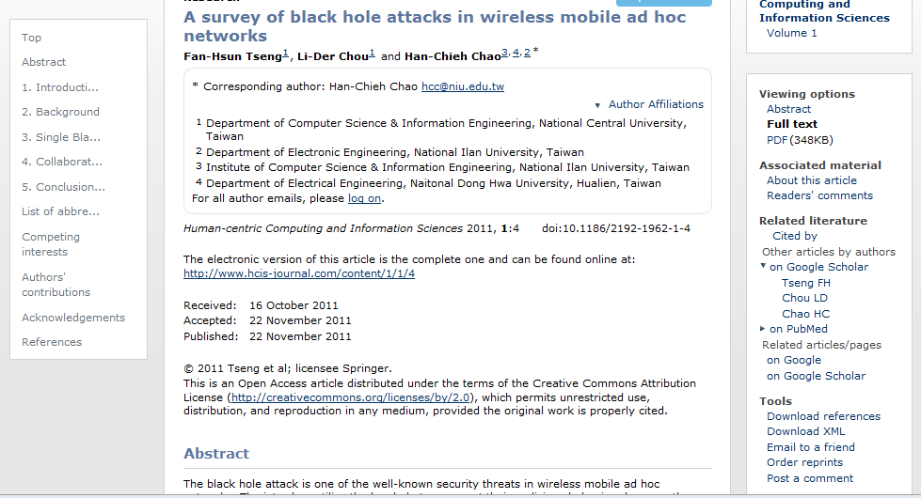
Article

Slide 17
Boolean Search
There is an option to do a straight Boolean Search utilizing one search bar. The user would have to write out the entire query including the Boolean Operator. An example, “network security” AND authentication written on the one line ……………………

Slide 18
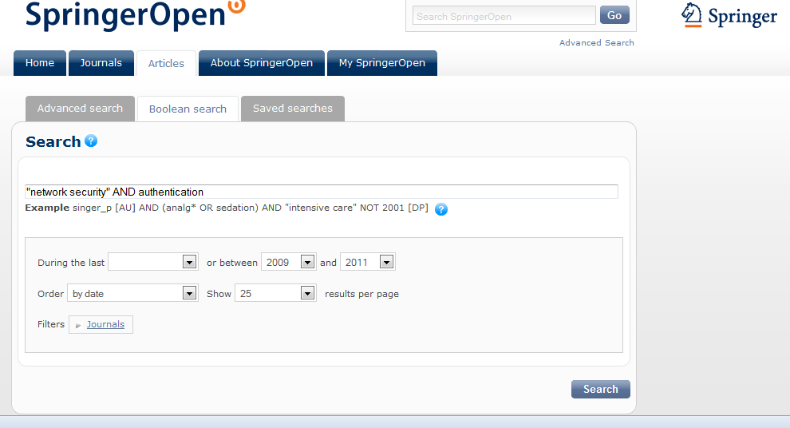
Boolean Search

Slide 19
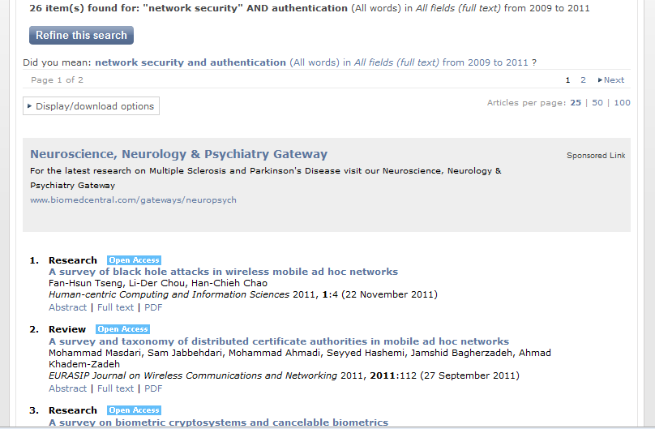
Boolean Search Results

Slide 20
Contact
If you have any questions please contact me at
Gregg Grunow
Online Librarian
ggrunow@ufairfax.edu
Or
librarian@ufairfax.edu

