Slide 1
arXiv.org
Tutorial

Slide 2
Introduction to arXiv.org
Open access database hosted by the Cornell University
Library
722,564 articles in the subject areas of:
Physics
Mathematics
Computer Science
Quantitative Biology
Quantitative Finance
Statistics
Each subject area can be searched individually

Slide 3
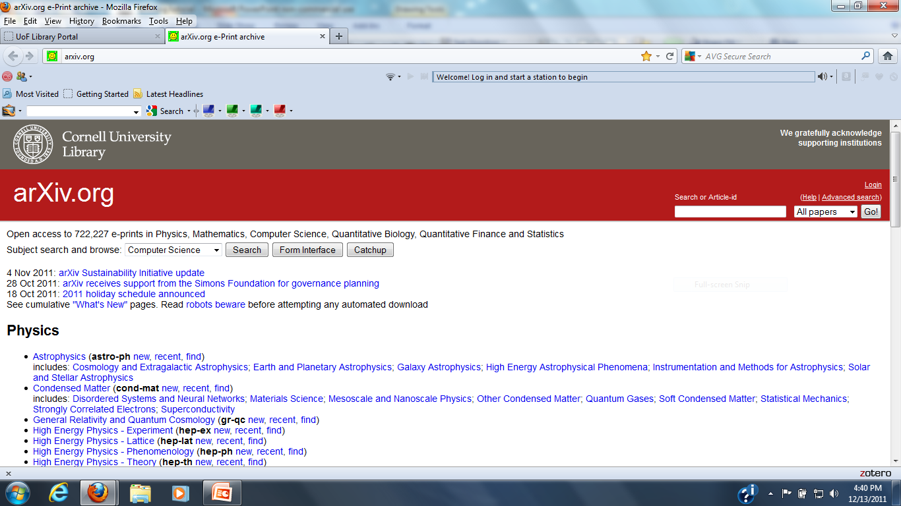
arXiv.org Home Page

Slide 4
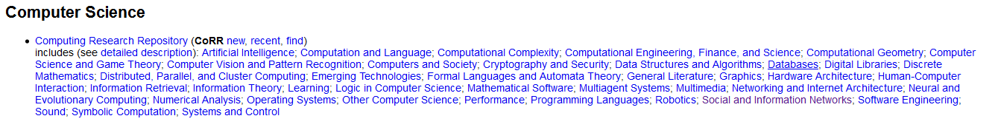
Computer Science Subtopics

Slide 5
Searching arXiv.org
The home page contains a search and browse option with a drop down menu allowing the user to choose the main subject area to be searched in this case Computer Science
Clicking of the search button brings you to the search page where the Computer Science option is pre-chosen
The user also has the option to choose any of the other subject areas or all of them
There is also a choice of time period to search
There are three search boxes connected by a choice of Boolean Operators. Each box has a drop down menu of search by choices such as author, title, full record, etc.

Slide 6
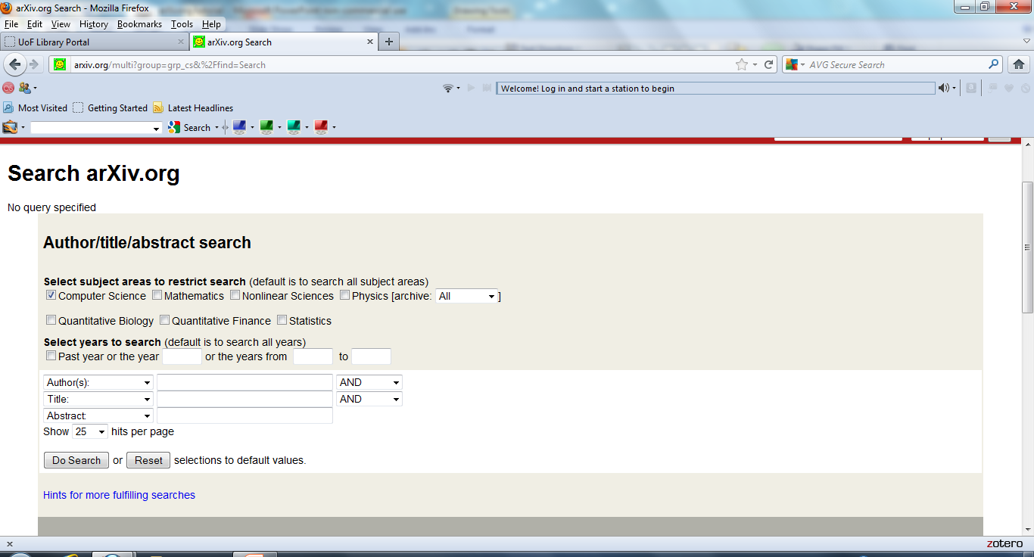
Search Page

Slide 7
Search Hints
The search page contains a very helpful section of hints on customizing/improving the users searches……..

Slide 8
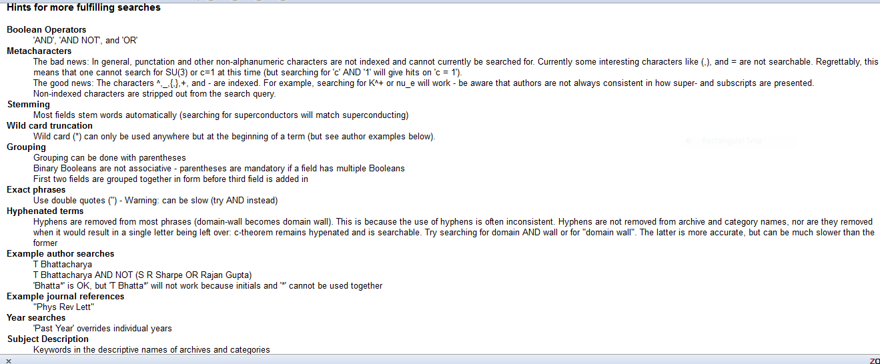
Search Hints

Slide 9
Search Example
In the following search example the search terms will include cryptography and security with a time choice of articles from the past year……….

Slide 10
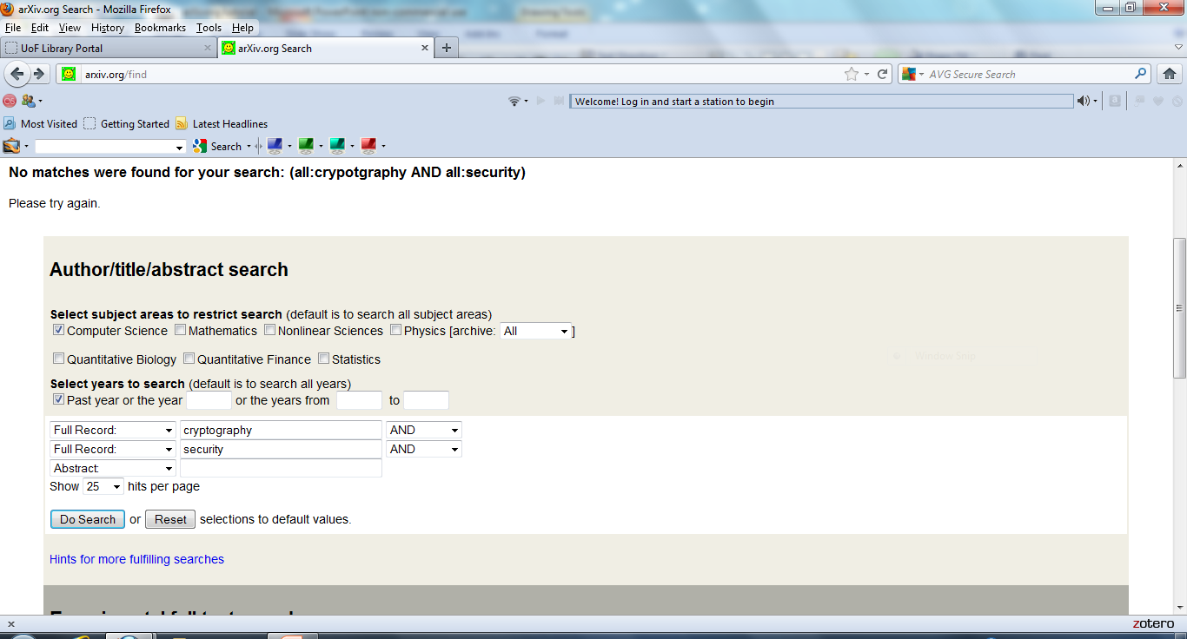
Advanced Search

Slide 11
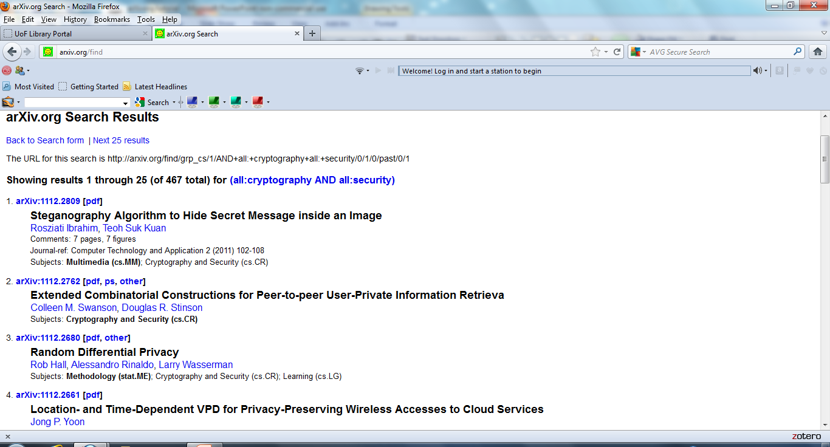
Search Results

Slide 12
Form Interface Options
On the arQiv.org home page there is another option for locating articles called the Form Interface. The button for Form Interface is next to the search button
In Form Interface there is a drop down menu of topics to search. Using the find button just beneath articles within the topic can be search by title, author, abstract, etc.
There view and listings options as well which will be discuss later

Slide 13
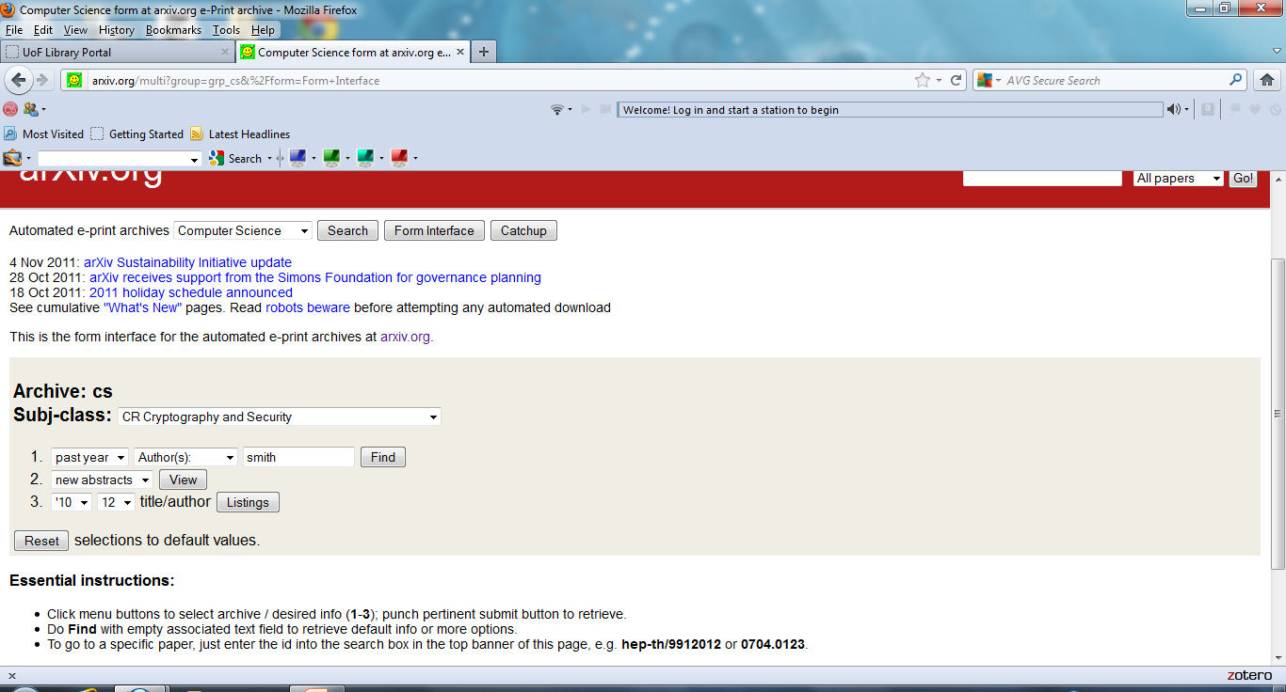
Form Interface

Slide 14
Form Interface Find
Using the Find function we will search for articles within the topic area of cryptography and security written by authors with the last name of Smith. Following is a piece of example of the results………..

Slide 15
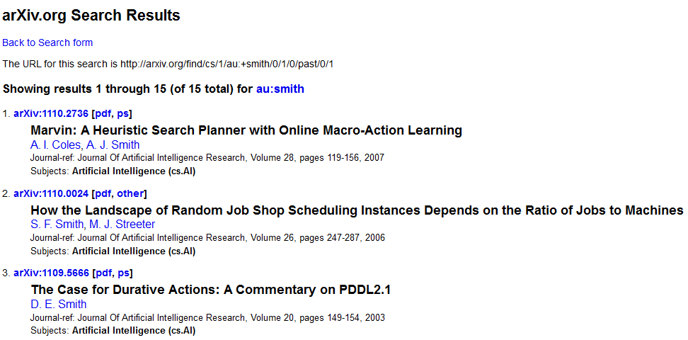
Form Interface-Find

Slide 16
Form Interface-View
Using the View option the user will see a list of new abstracts and articles recently added to the database.
In this case under the topic Cryptography and Security……………..

Slide 17
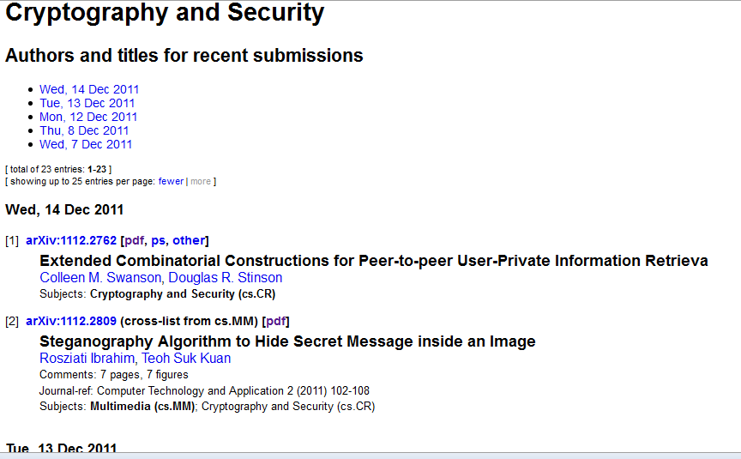
Form Interface-View Recent

Slide 18
Form Interface-Listings by Date
The user can also view articles within a topic area that were added to the database by month and year. In this case articles added in December of 2010 under the topic Cryptography and Security……..

Slide 19
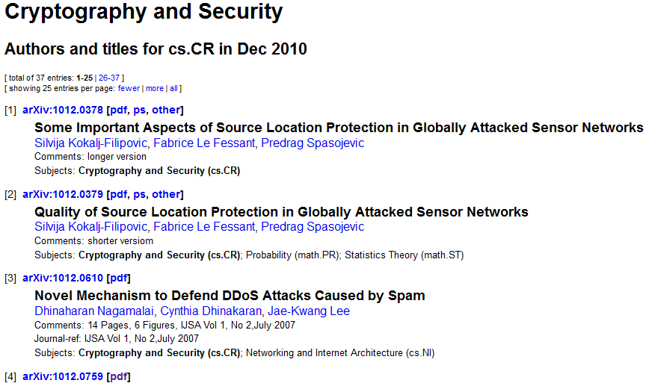
Form Interface-Listings by Date

Slide 20
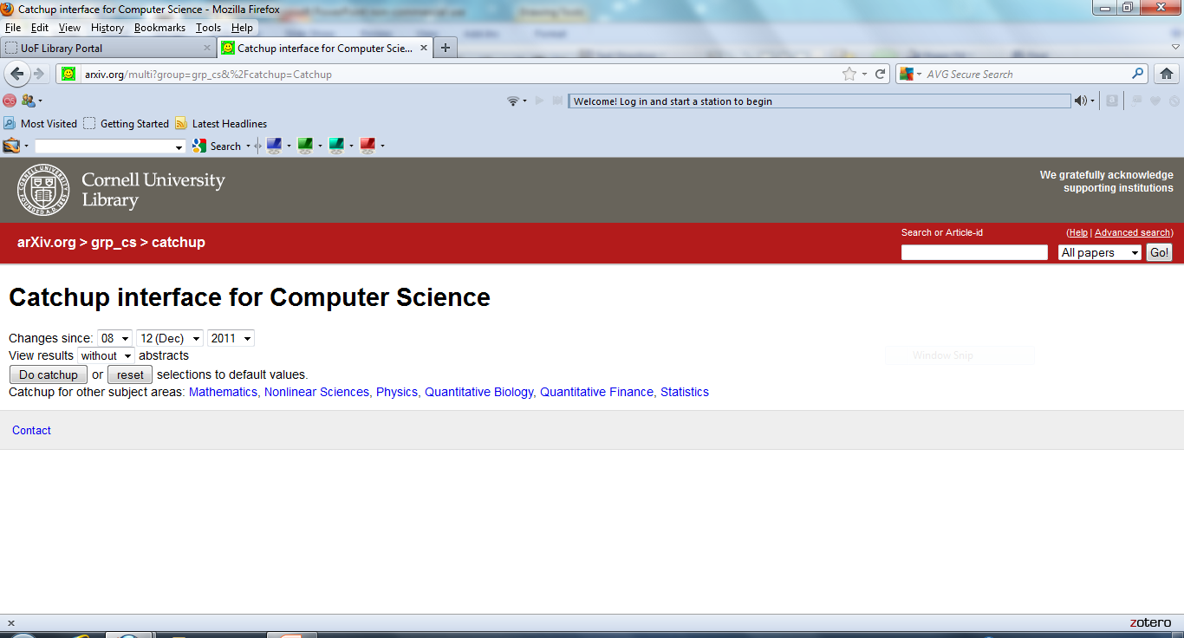
Catchup Interface

Slide 21
Catchup
With the Catchup option on the ArQiv.org home page the user is able to see a list of articles added since a date to be chosen by the user………

Slide 22
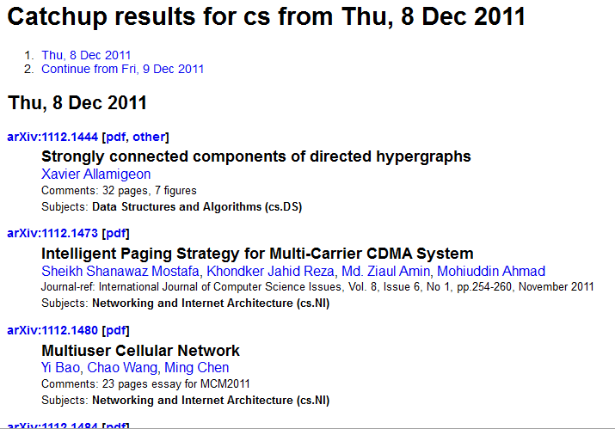
Catchup Results from 12/8/2011

Slide 23
Contact
If you have any questions please contact me at:
Gregg Grunow
Online Librarian
ggrunow@ufairfax.edu
Or
librarian@ufairfax.edu

